Slide 1
Power Bi capstone -2
SUPERMARKET SALES
Submitted by
Shaik Reshma

Slide 2
Data cleaning
Loading data from Text/csv
Transforming data to power query
Checking for errors & null values
From the given data “Date” column is not in good format . I have changed the data type by using locale.

Slide 3
Data preprocessing
From the date column I have created some calculated columns
Month
Year
Month name
Day
Weekend
Week name

Slide 4
Data Analysis
Did some analysis from the data using measure.
Total Transactions
Weekend Transactions
Total sales by customer type
Total Quantity sold
Total sales
Total sales by Gender

Slide 5
Data Visualization
I have created a report(Dashboard) and named it as “Supermarket sales” by using different types of visualizations so that the user can understand the complete analysis of data in just one view
Matrix (Applied conditional formatting)
Map (which shows Total transactions by city)
Topline products
Gender count
Cards , Multi row cards, pie chart , Column charts ,bar chart and slicers.

Slide 6
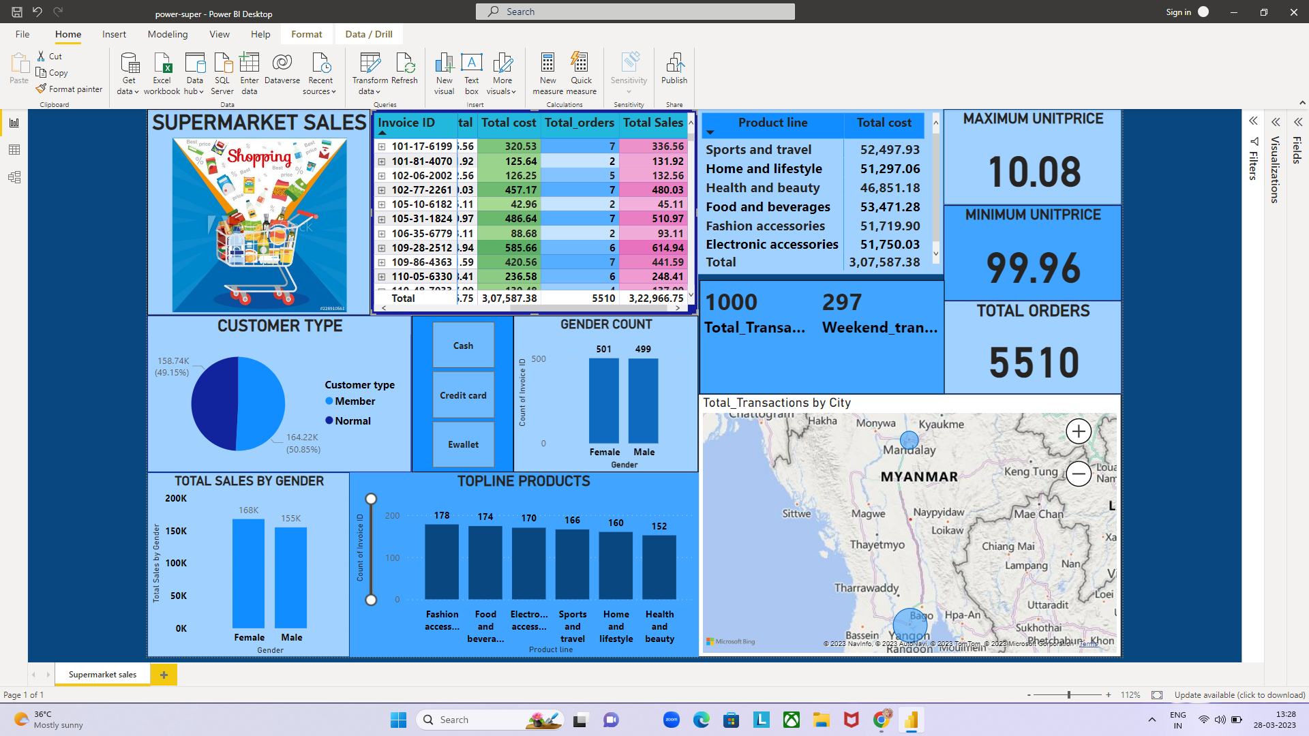
Dashboard
-Supermarket sales

Slide 7
Conclusion
This visualizations , report view , data analysis and some meaningful insights helps the company to track their transactions ,sales , Topline products , Gender wise sales , weekend sales and many more.
And can understand the performance for each product-brand and compare regional performance

